Slide 1



SMART INDIA HACKATHON 2026
TITLE PAGE
Problem Statement ID – SIH26076
Problem Statement Title- Development of a personalized homepage for the 'Mausam' mobile app.
Theme- Miscellaneous
PS Category- Software
Team ID-
Team Name (Registered on portal) - AetherX

Slide 2

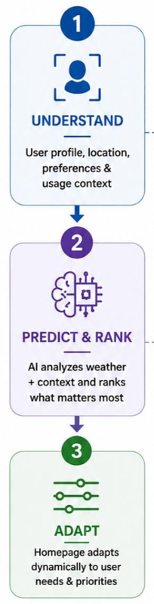
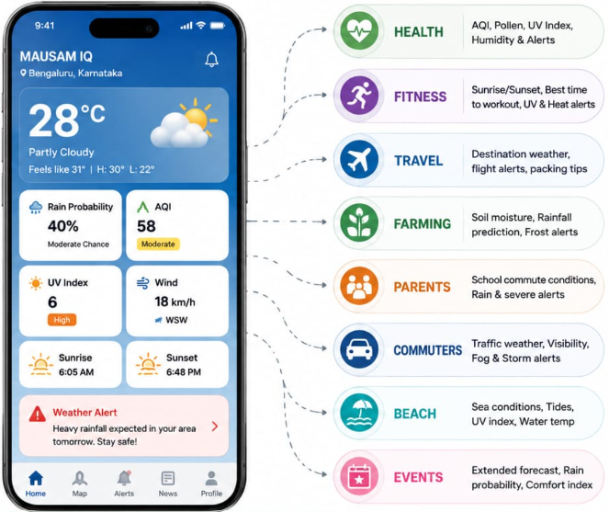

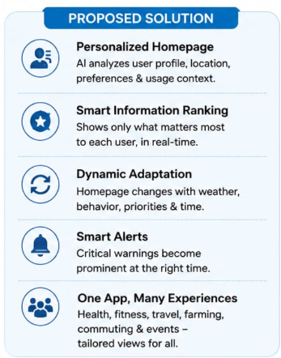

OUR SOLUTION
AetherX
@SIH Idea submission- Template
2
Notes:
2

Slide 3
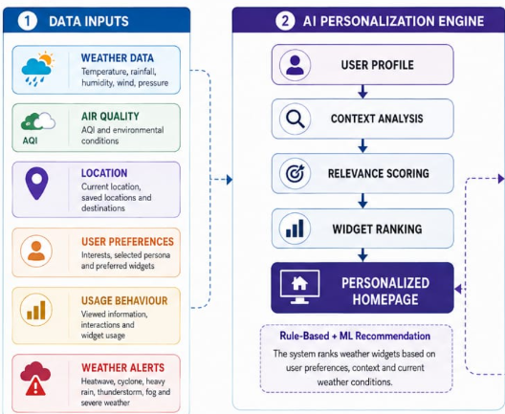
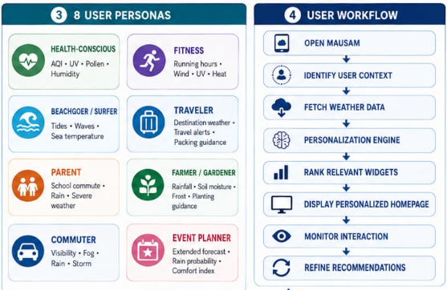
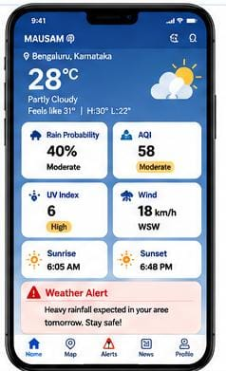
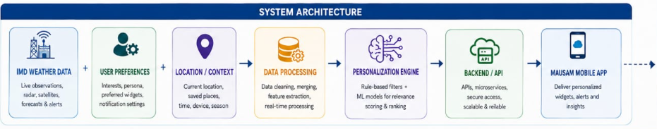
TECHNICAL APPROACH
AetherX
@SIH Idea submission- Template
3
Notes:
3

Slide 4
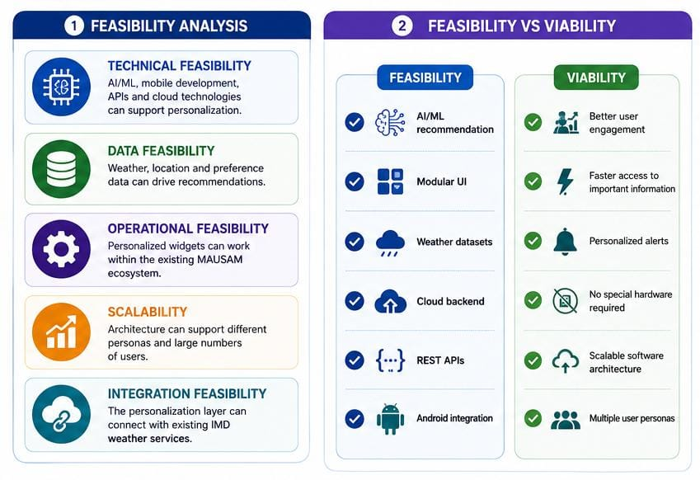
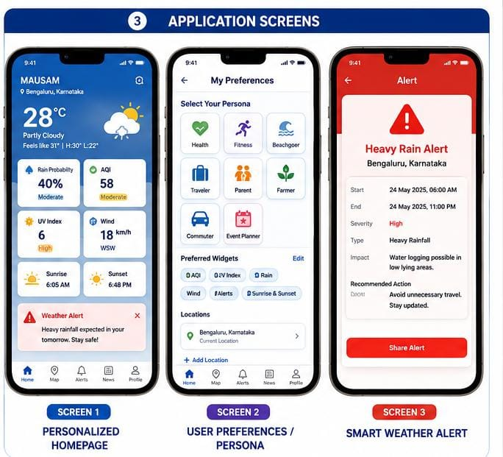
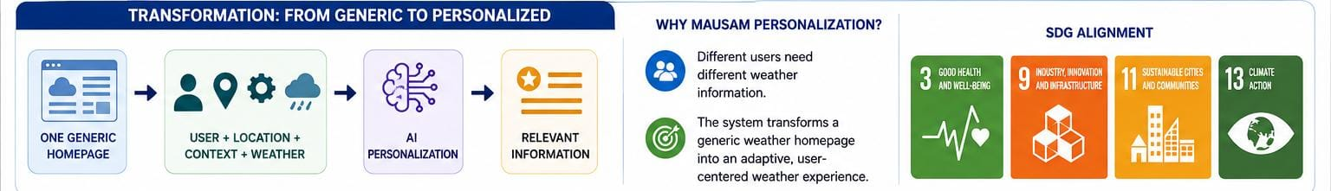
FEASIBILITY AND VIABILITY
AetherX
@SIH Idea submission- Template
4
Notes:
4

Slide 5

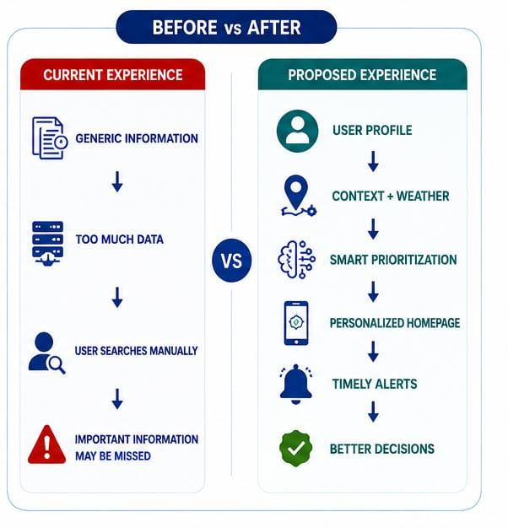
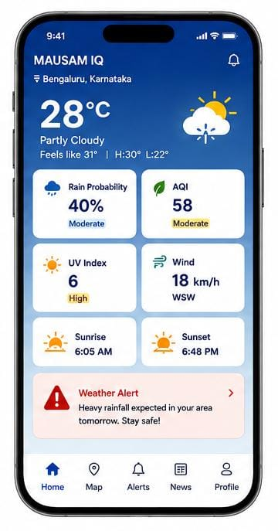

AetherX
IMPACT AND BENEFITS
@SIH Idea submission- Template
5
Notes:
5

Slide 6
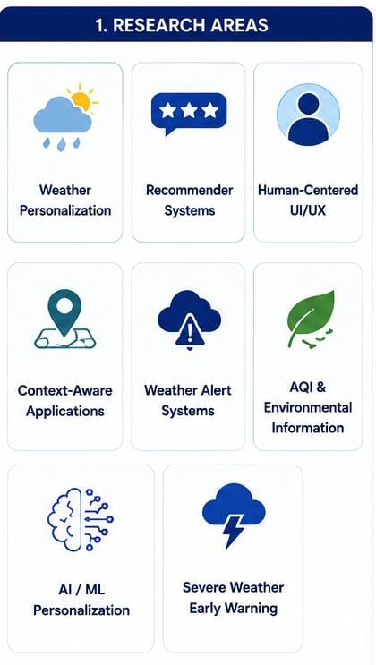

RESEARCH AND REFERENCES
AetherX
@SIH Idea submission- Template
6
Notes:
6

